Slide 1

Chapter 13
Advanced Implementation of Tables
© 2011 Pearson Addison-Wesley. All rights reserved
13 A-<number>

Slide 2
Balanced Search Trees
The efficiency of the binary search tree implementation of the ADT table is related to the tree’s height
  Height of a binary search tree of n items
    Maximum: n
    Minimum: ⎡log₂(n + 1)⎤
Height of a binary search tree is sensitive to the order of insertions and deletions
Variations of the binary search tree
  Can retain their balance despite insertions and deletions
© 2011 Pearson Addison-Wesley. All rights reserved
13 A-<number>

Slide 3
2-3 Trees
A 2-3 tree
  Has 2-nodes and 3-nodes
    A 2-node
      A node with one data item and two children
    A 3-node
      A node with two data items and three children
  Is not a binary tree
  Is never taller than a minimum-height binary tree
    A 2-3 tree with n nodes never has height greater than
    ⎡log₂(n + 1)⎤
© 2011 Pearson Addison-Wesley. All rights reserved
13 A-<number>

Slide 4
2-3 Trees
Rules for placing data items in the nodes of a 2-3 tree
  A 2-node must contain a single data item whose search key is
    Greater than the left child’s search key(s)
    Less than the right child’s search(s)
  A 3-node must contain two data items whose search keys S and L satisfy the following
    S is
      Greater than the left child’s search key(s)
      Less than the middle child’s search key(s)
    L is
      Greater than the middle child’s search key(s)
      Less than the right child’s search key(s)
  A leaf may contain either one or two data items
© 2011 Pearson Addison-Wesley. All rights reserved
13 A-<number>

Slide 5
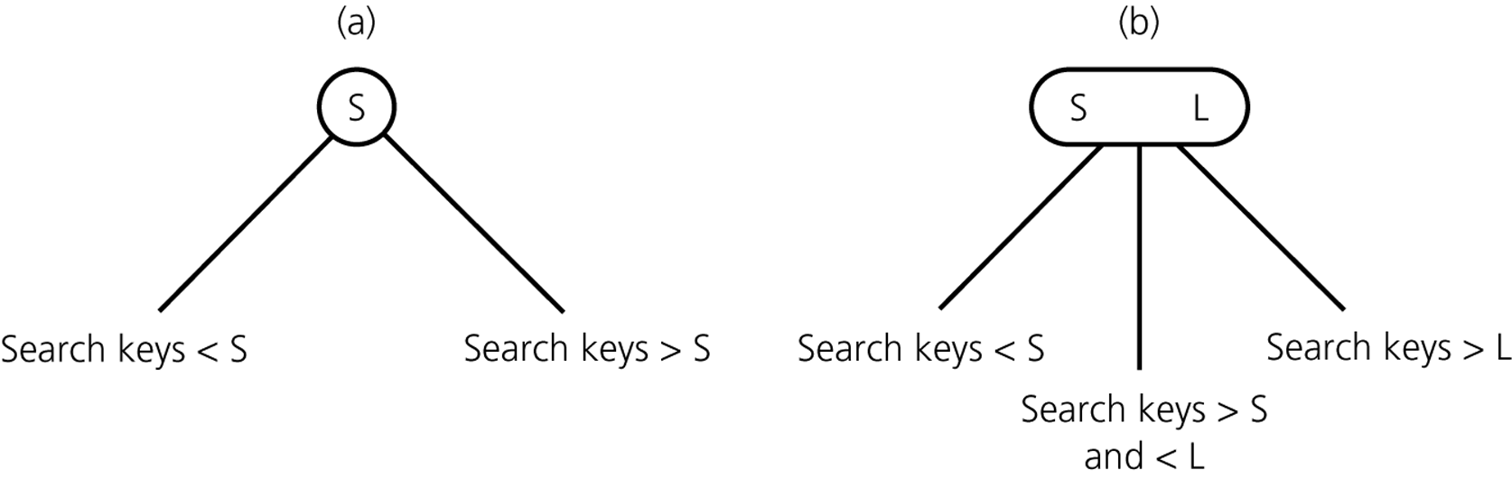
2-3 Trees
Figure 13-3
Nodes in a 2-3 tree a) a 2-node; b) a 3-node
© 2011 Pearson Addison-Wesley. All rights reserved
13 A-<number>

Slide 6
2-3 Trees
Traversing a 2-3 tree
  To traverse a 2-3 tree
    Perform the analogue of an inorder traversal
Searching a 2-3 tree
  Searching a 2-3 tree is as efficient as searching the shortest binary search tree
    Searching a 2-3 tree is O(log₂n)
    Number of comparisons required to search a 2-3 tree for a given item
      Approximately equal to the number of comparisons required to search a binary search tree that is as balanced as possible
© 2011 Pearson Addison-Wesley. All rights reserved
13 A-<number>

Slide 7
2-3 Trees
Advantage of a 2-3 tree over a balanced binary search tree
  Maintaining the balance of a binary search tree is difficult
  Maintaining the balance of a 2-3 tree is relatively easy
© 2011 Pearson Addison-Wesley. All rights reserved
13 A-<number>

Slide 8
2-3 Trees: Inserting Into a 2-3 Tree
Insertion into a 2-node leaf is simple
Insertion into a 3-node causes it to divide
© 2011 Pearson Addison-Wesley. All rights reserved
13 A-<number>

Slide 9
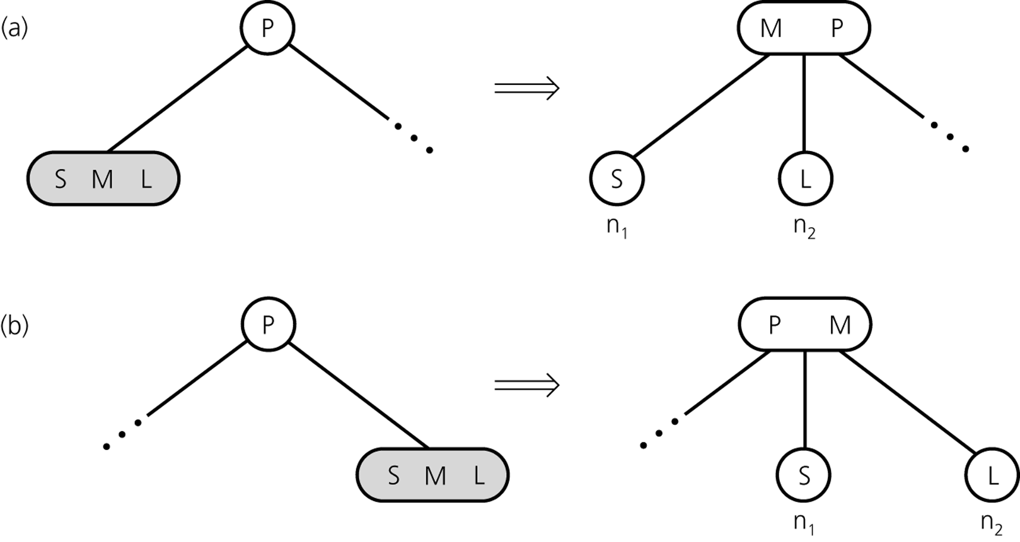
2-3 Trees: The Insertion Algorithm
To insert an item I into a 2-3 tree
  Locate the leaf at which the search for I would terminate
  Insert the new item I into the leaf
  If the leaf now contains only two items, you are done
  If the leaf now contains three items, split the leaf into two nodes, n₁ and n₂
Figure 13-12
Splitting a leaf in a 2-3 tree
© 2011 Pearson Addison-Wesley. All rights reserved
13 A-<number>

Slide 10
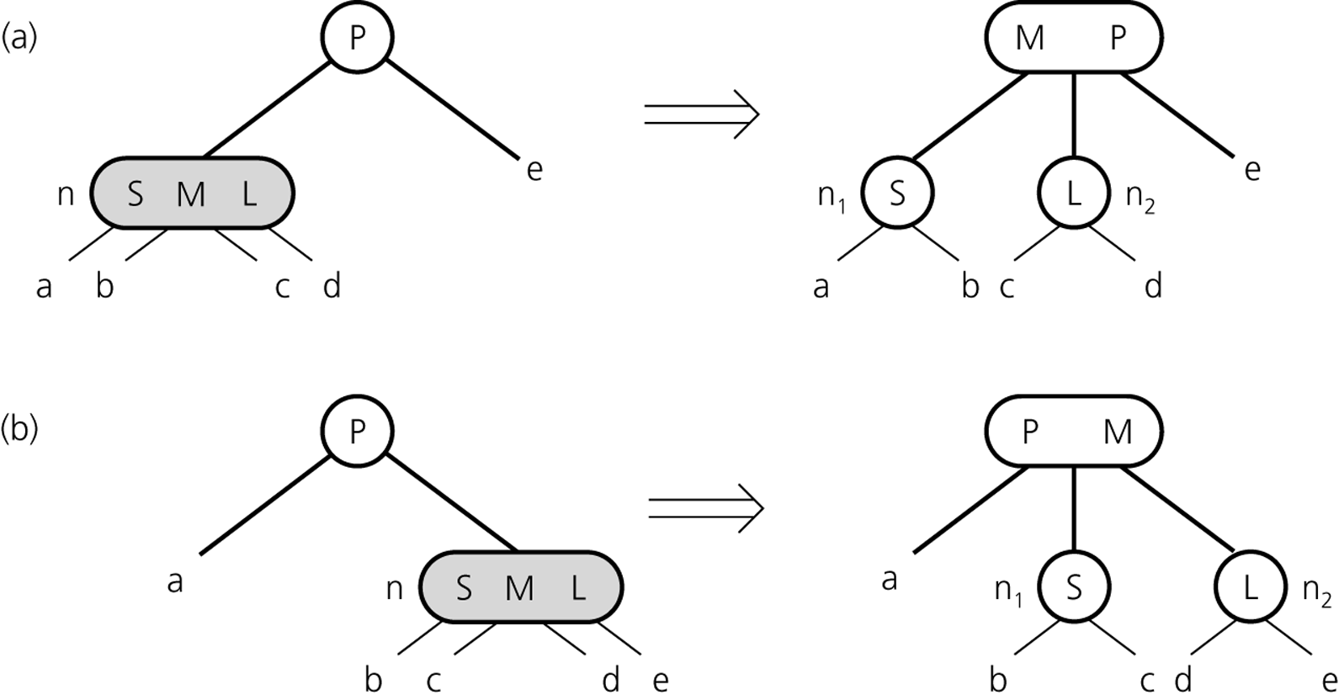
2-3 Trees: The Insertion Algorithm
When an internal node contains three items
  Split the node into two nodes
  Accommodate the node’s children
Figure 13-13
Splitting an internal node in a 2-3 tree
© 2011 Pearson Addison-Wesley. All rights reserved
13 A-<number>

Slide 11
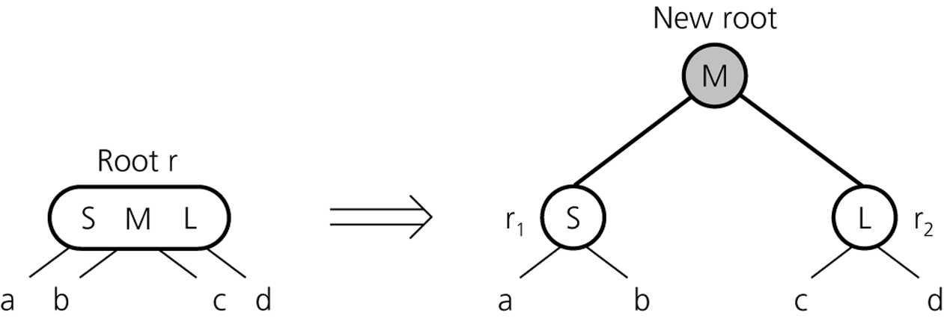
2-3 Trees: The Insertion Algorithm
When the root contains three items
  Split the root into two nodes
  Create a new root node
Figure 13-14
Splitting the root of a 2-3 tree
© 2011 Pearson Addison-Wesley. All rights reserved
13 A-<number>

Slide 12
2-3 Trees: Deleting from a 2-3 Tree
Deletion from a 2-3 tree
  Does not affect the balance of the tree
Deletion from a balanced binary search tree
  May cause the tree to lose its balance
© 2011 Pearson Addison-Wesley. All rights reserved
13 A-<number>

Slide 13
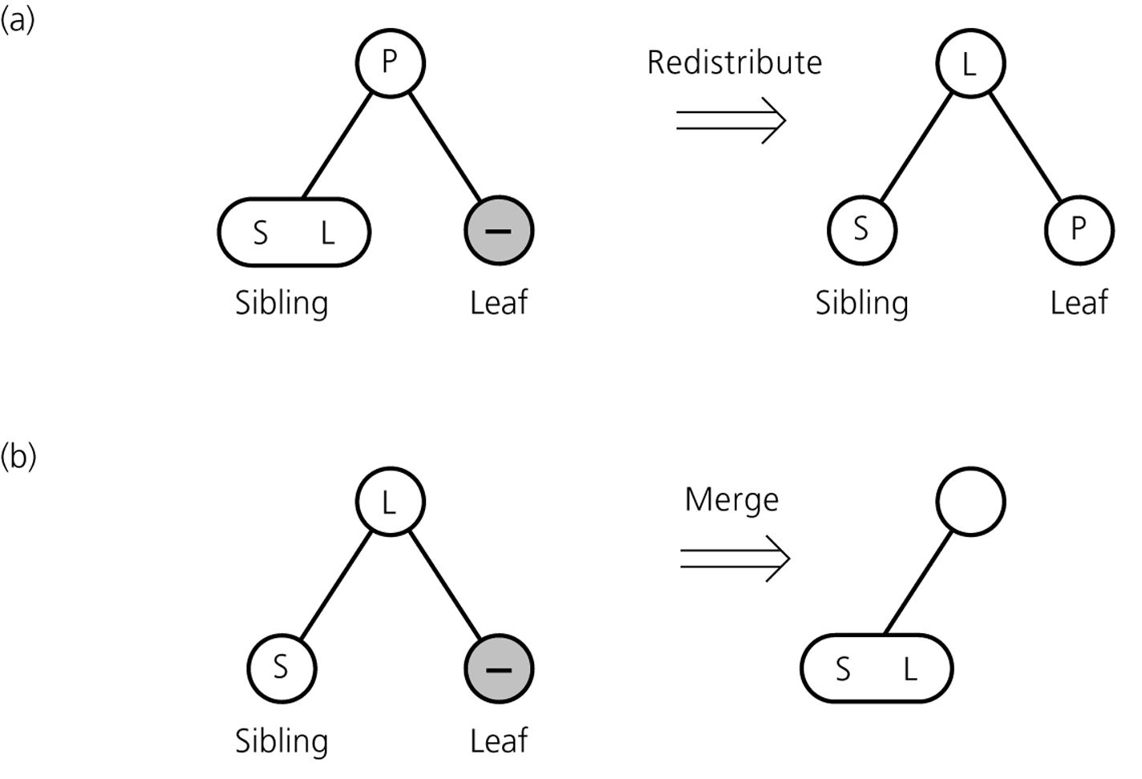
2-3 Trees: The Deletion Algorithm
Figure 13-19a and 13-19b
a) Redistributing values; b) merging a leaf
© 2011 Pearson Addison-Wesley. All rights reserved
13 A-<number>

Slide 14
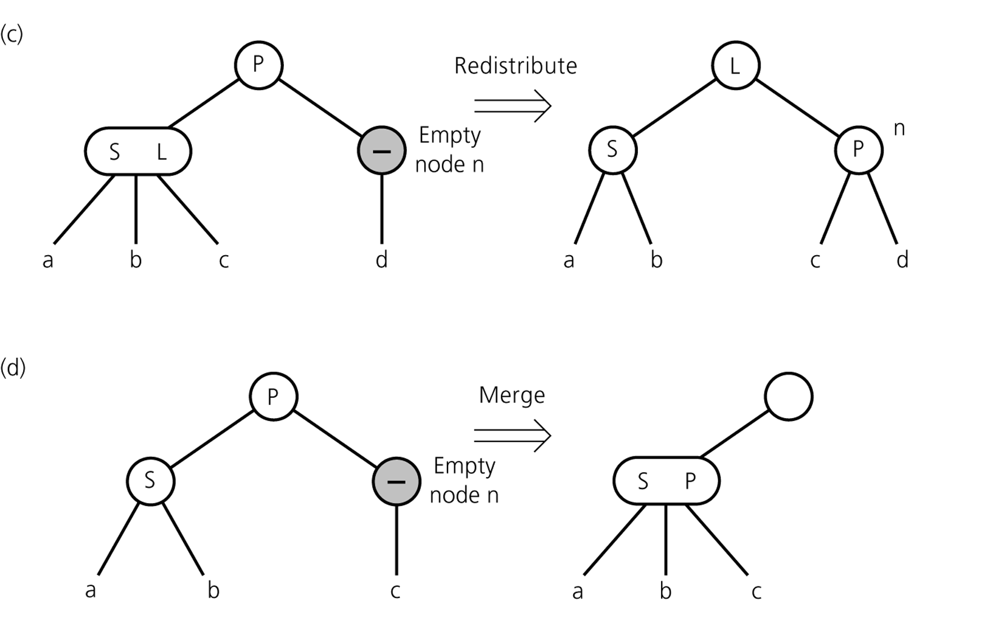
2-3 Trees: The Deletion Algorithm
Figure 13-19c and 13-19d
c) redistributing values and children; d) merging internal nodes
© 2011 Pearson Addison-Wesley. All rights reserved
13 A-<number>

Slide 15
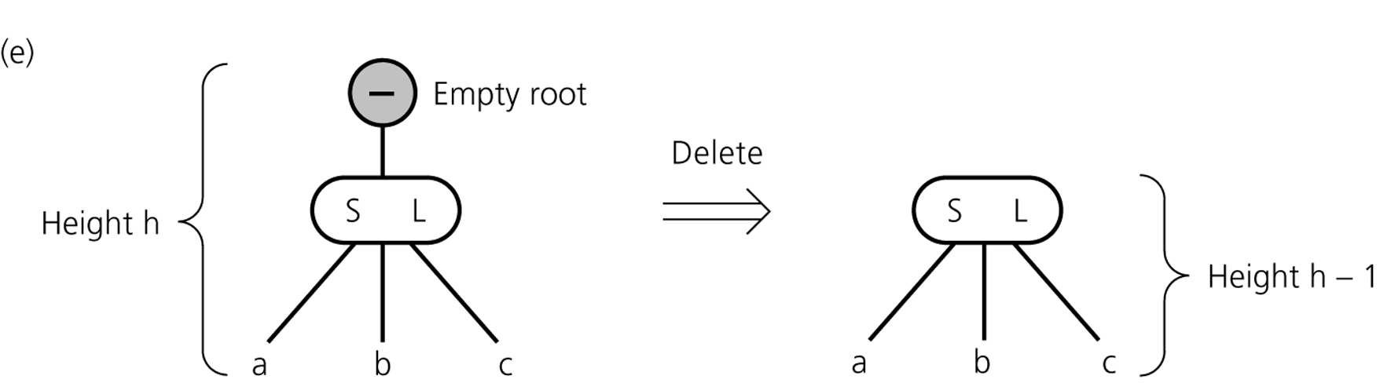
2-3 Trees: The Deletion Algorithm
Figure 13-19e
e) deleting the root
© 2011 Pearson Addison-Wesley. All rights reserved
13 A-<number>

Slide 16
2-3 Trees: The Deletion Algorithm
When analyzing the efficiency of the insertItem and deleteItem algorithms, it is sufficient to consider only the time required to locate the item
A 2-3 implementation of a table is O(log₂n) for all table operations
A 2-3 tree is a compromise
  Searching a 2-3 tree is not quite as efficient as searching a binary search tree of minimum height
  A 2-3 tree is relatively simple to maintain
© 2011 Pearson Addison-Wesley. All rights reserved
13 A-<number>

Slide 17
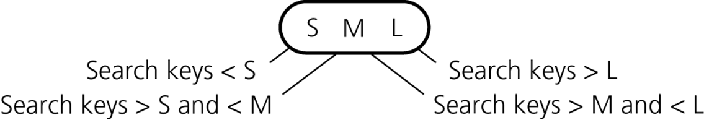
2-3-4 Trees
Rules for placing data items in the nodes of a 2-3-4 tree
  A 2-node must contain a single data item whose search keys satisfy the relationships pictured in Figure 13-3a
  A 3-node must contain two data items whose search keys satisfy the relationships pictured in Figure 13-3b
  A 4-node must contain three data items whose search keys S, M, and L satisfy the relationship pictured in Figure 13-21
  A leaf may contain either one, two, or three data items
Figure 13-21
A 4-node in a 2-3-4 tree
© 2011 Pearson Addison-Wesley. All rights reserved
13 A-<number>

Slide 18
2-3-4 Trees: Searching and Traversing a 2-3-4 Tree
Search and traversal algorithms for a 2-3-4 tree are simple extensions of the corresponding algorithms for a 2-3 tree
© 2011 Pearson Addison-Wesley. All rights reserved
13 A-<number>

Slide 19
2-3-4 Trees: Inserting into a 2-3-4 Tree
The insertion algorithm for a 2-3-4 tree
  Splits a node by moving one of its items up to its parent node
  Splits 4-nodes as soon as its encounters them on the way down the tree from the root to a leaf
    Result: when a 4-node is split and an item is moved up to the node’s parent, the parent cannot possibly be a 4-node and can accommodate another item
© 2011 Pearson Addison-Wesley. All rights reserved
13 A-<number>

Slide 20
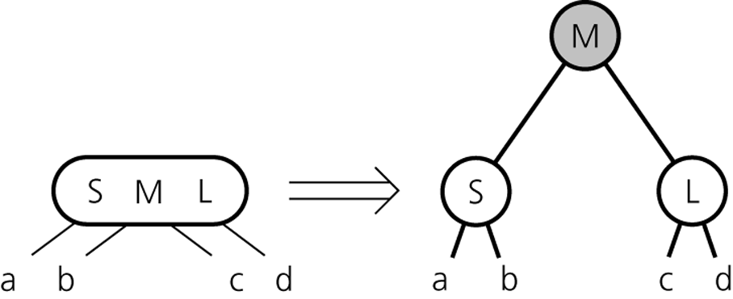
2-3-4 Trees: Splitting 4-nodes During Insertion
A 4-node is split as soon as it is encountered during a search from the root to a leaf
The 4-node that is split will
  Be the root, or
  Have a 2-node parent, or
  Have a 3-node parent
Figure 13-28
Splitting a 4-node root during insertion
© 2011 Pearson Addison-Wesley. All rights reserved
13 A-<number>

Slide 21
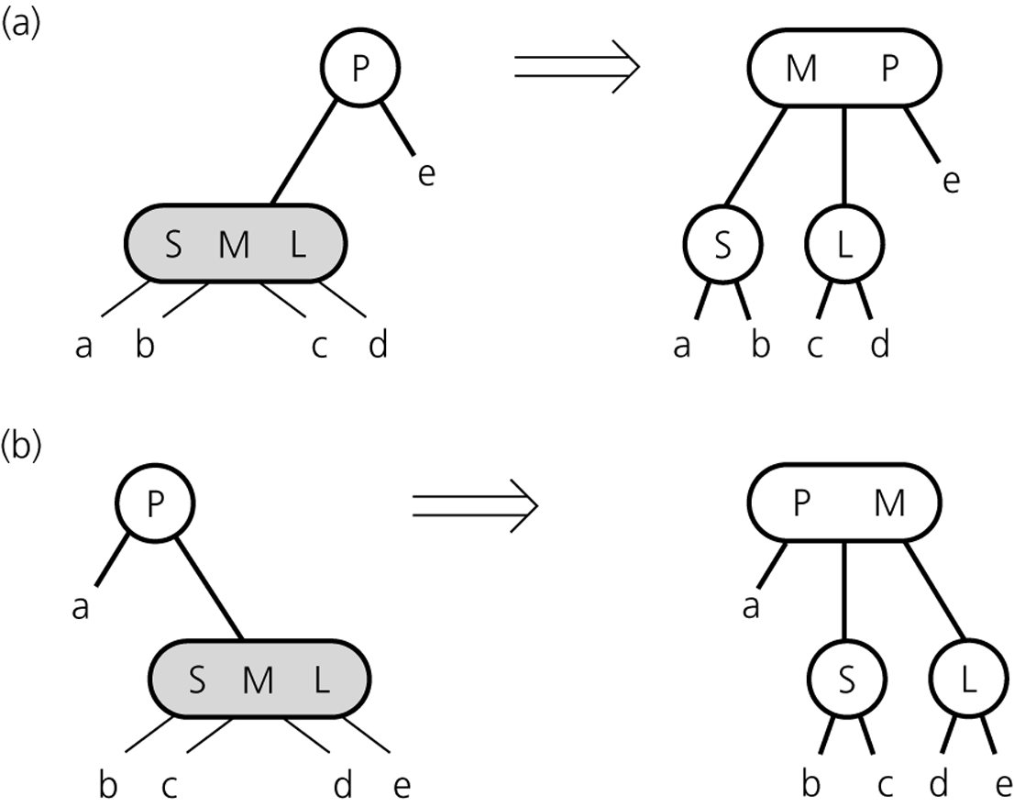
2-3-4 Trees: Splitting 4-nodes During Insertion
Figure 13-29
Splitting a 4-node whose parent is a 2-node during insertion
© 2011 Pearson Addison-Wesley. All rights reserved
13 A-<number>

Slide 22
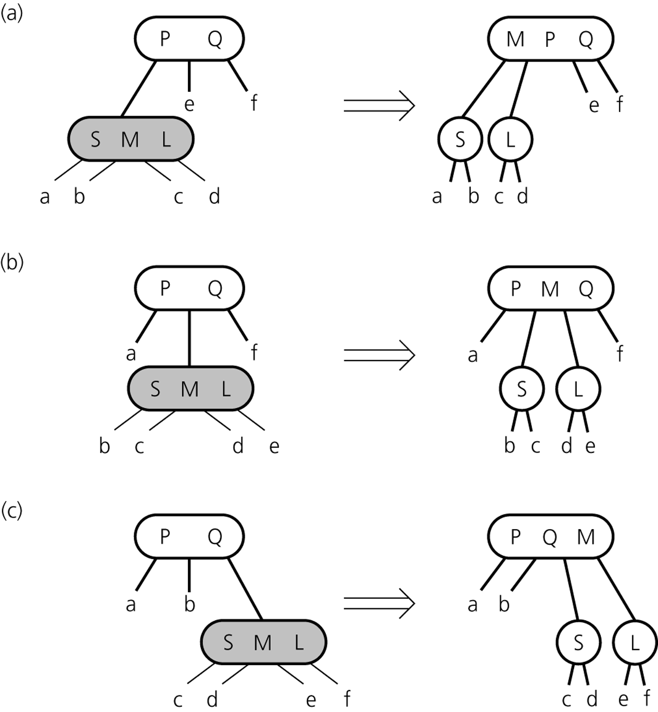
2-3-4 Trees: Splitting 4-nodes During Insertion
Figure 13-30
Splitting a 4-node whose parent is a 3-node during insertion
© 2011 Pearson Addison-Wesley. All rights reserved
13 A-<number>

Slide 23
2-3-4 Trees: Deleting from a
2-3-4 Tree
The deletion algorithm for a 2-3-4 tree
  Locate the node n that contains the item theItem
  Find theItem’s inorder successor and swap it with theItem (deletion will always be at a leaf)
  If that leaf is a 3-node or a 4-node, remove theItem
  To ensure that theItem does not occur in a 2-node
    Transform each 2-node encountered into a 3-node or a 4-node
© 2011 Pearson Addison-Wesley. All rights reserved
13 A-<number>

Slide 24
2-3-4 Trees: Concluding Remarks
Advantage of 2-3 and 2-3-4 trees
  Easy-to-maintain balance
Insertion and deletion algorithms for a 2-3-4 tree require fewer steps that those for a 2-3 tree
Allowing nodes with more than four children is counterproductive
© 2011 Pearson Addison-Wesley. All rights reserved
13 A-<number>

Slide 25
Please open file carrano_ppt13_B.ppt
to continue viewing chapter 13.
© 2011 Pearson Addison-Wesley. All rights reserved
13 A-<number>

